Slide 1


COMPUTER NETWORKS MINI PROJECT
Mukundaan.S
Adithya Dutt Kambhampati
Keerthi Kiriti Chakali

Slide 2

Abstract:
Office management system helps to maintain a close relationship between the different departments and people.
It helps in transition between various departments in an office using minimal number of routers.
The Admin can track all the information of Time Entries, Resources, Offices etc.
Office Management refers to the entire process and procedure of managing office documents from all the departments. Be it the customer feedback or financial statements, documenting all of these in order to maintain their records for professional purposes of the company is known as office management. There are numerous ways of managing documentation, from maintaining hard copies to saving scanned files or opting for software assistance.

Slide 3

Office Management is a major constituent in the functioning of every enterprise. It includes all aspects like planning, documentation, coordination and maintenance of office records and employees.
Depending upon the kind of enterprise, there are different types of office management system.
The basic idea behind managing an office is to ensure that there is proper control over every element of the work space in order to enhance the proficiency and productivity of the organization.
In this project we have used CISCO packet tracer with 5 attributes and connected them with (3) routers (5)switches and connected them together. This helps to easily share data.

Slide 4
DESCRIPTION OF OFFICE MANAGEMENT SYSTEM DATABASE:
The details of Offices is store into the Offices tables respective with all tables Each entity (Time Entries, Resources, Attendance, Employees, Offices) contains primary
key and unique keys. • The entity Resources, Attendance has binded with Offices, Employees entities with foreign key
.There is one-to-one and one-to-many relationships available between Attendance, Tasks, Time Entries, Offices All the entities Offices, Attendance, Resources, Time Entries are normalized and reduce duplicacy of records
We have implemented indexing on each tables of Office Management System tables for fast query execution.

Slide 5
TASKS ENTITY: ATTRIBUTES OF TASKS ARE TASK_ID, TASK_EMPLOYEE_ID, TASK_NAME, TASK_TYPE, TASK_DESCRIPTION
Attendance Entity: Attributes of Attendance are attendance_id, attendance_employee_id, attendance_type, attendance_description
Time Entries Entity: Attributes of Time Entries are time_emtery_id, time_emtery_employee_id, time_emtery_type, time_emtery_description

Slide 6
OFFICE MANAGEMENT SYSTEM ENTITIES AND THEIR ATTRIBUTES:
Offices Entity: Attributes of Offices are office_id, office_company_id, office_employee_id, office_name, office_place, office_type, office_address Employees Entity: Attributes of Employees are
employee_id, employee_name, employee_mobile, employee_email, employee_username, employee password, employee_address
Resources Entity Attributes of Resources are resource_id, resource_employee resour ame, resource_type, resource_description

Slide 7

This ER (Entity Relationship) Diagram represents the model of Office Management System Entity. The entity-relationship diagram of Office Management System shows all the visual instru ment of database tables and the relations between Employees, Tasks, Offices, Time Entries etc. It used structure data and to define the relationships between structured data groups of Office Management System functionalities. The main entities of the Office Management System are Offices, Employees, Resources, Tasks, Attendance and Time Entries.

Slide 8
ER-Diagram

Slide 9
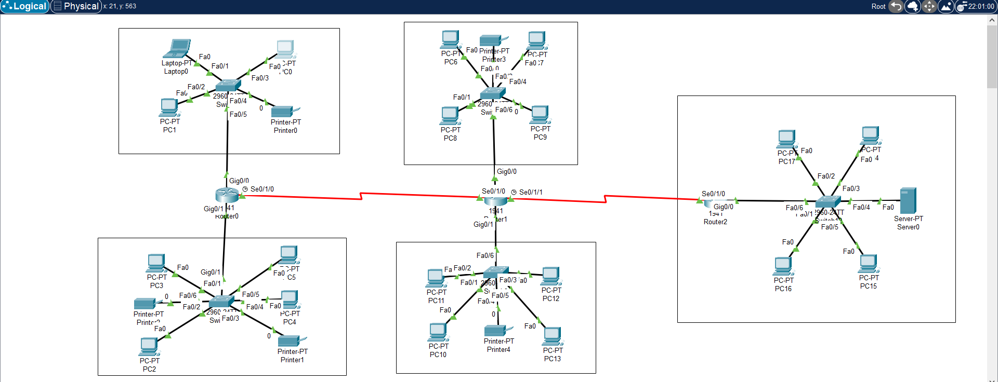
CISCO PACKET TRACER-OFFICE MANAGEMENT SYSTEM

